Slide 1

Car prices Data Analysis – Module 1
An overview of dataset analysis using Dask.
By
Shobharani

Slide 2
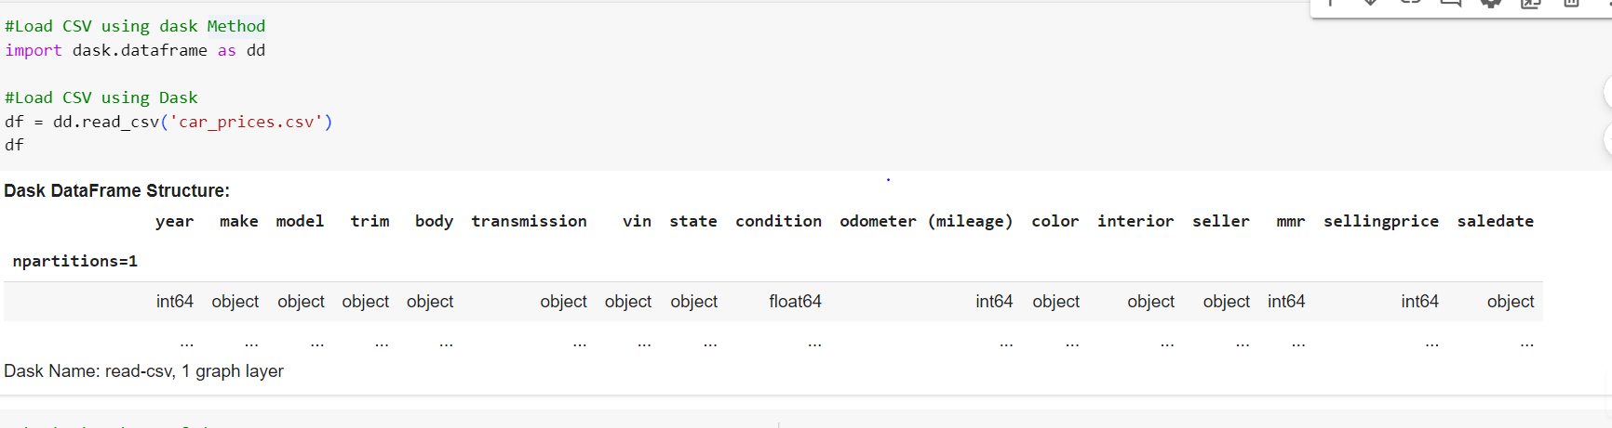
Loading CSV Data using with Dask
To load data using Dask, use the read_csv method:
import dask.dataframe as dd Load CSV using Dask
df = dd.read_csv('car_prices.csv')
df

Slide 3
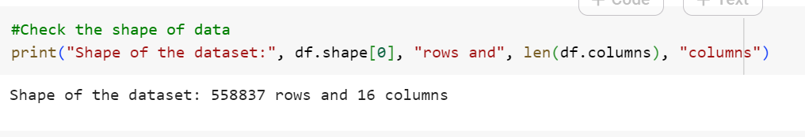
Data Shape
The shape of the dataset can be obtained using df.shape. This provides the number of rows and columns.
print("Shape of the dataset:", df.shape[0], "rows and", len(df.columns), "columns")

Slide 4
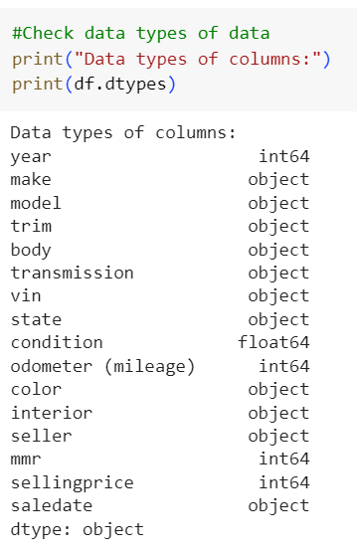
Data Types
Data types of the dataset can be listed using df.dtypes, which shows the type for each column.

Slide 5
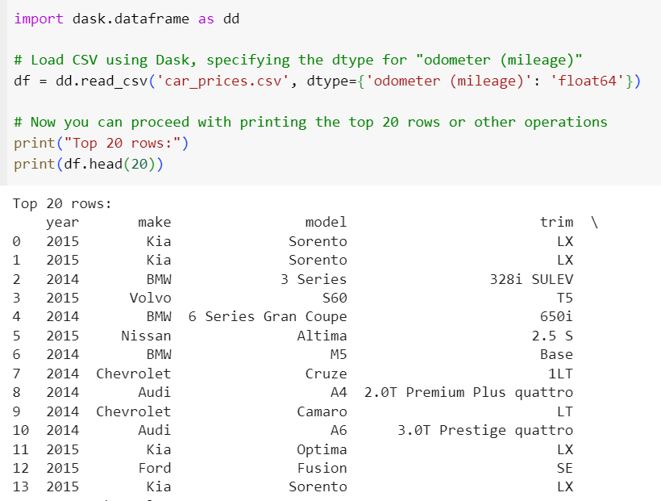
Top 20 Rows
Display the top 20 rows of the dataset using df.head(20).

Slide 6
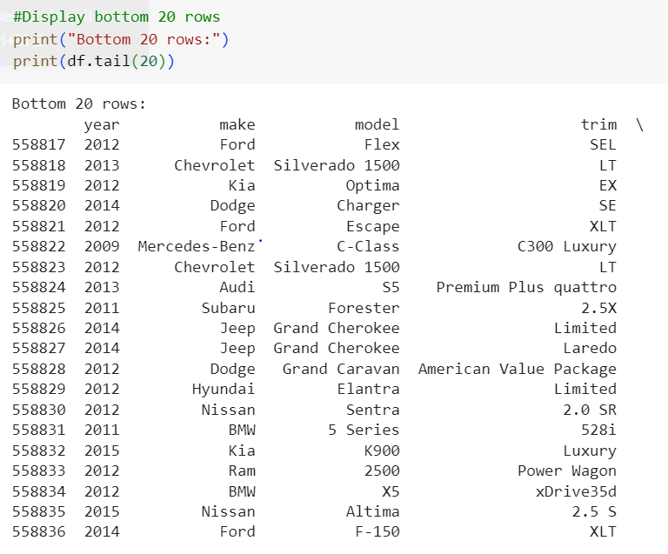
Bottom 20 Rows
Display the bottom 20 rows of the dataset using df.tail(20).

Slide 7
Hypotheses
Hypothesis 1: Car price correlates positively with the number of cylinders.
Null Hypothesis (H0): There is no correlation between car price and the number of cylinders.
Alternate Hypothesis (H1): There is a positive correlation between car price and the number of cylinders.
Hypothesis 2: Cars with higher horsepower tend to have higher prices.
Null Hypothesis (H0): There is no correlation between car price and horsepower.
Alternate Hypothesis (H1): There is a positive correlation between car price and horsepower.
Hypothesis 3: Fuel efficiency (mpg) negatively correlates with price.
Null Hypothesis (H0): There is no correlation between car price and fuel efficiency (mpg).
Alternate Hypothesis (H1): There is a negative correlation between car price and fuel efficiency (mpg).

Slide 8
Hypothesis
Hypothesis 4: Cars from certain brands (e.g., luxury brands) have higher average prices.
Null Hypothesis (H0): There is no difference in average prices between luxury and non-luxury car brands.
Alternate Hypothesis (H1): Luxury car brands have a higher average price compared to non-luxury brands.
Hypothesis 5: The age of the car (model year) inversely affects the price.
Null Hypothesis (H0): There is no correlation between car price and model year.
Alternate Hypothesis (H1): There is a negative correlation between car price and model year (older cars are cheaper).

Slide 9
Classification or Prediction Experiment
Prediction:
I would suggest a prediction experiment focusing on car price prediction.
Here's why:
Reasons for Prediction: Continuous Target Variable: The target variable you're interested in, "sellingprice," is continuous (numerical values).
Classification is typically used for categorical target variables (e.g., predicting if a car is "luxury" or "non-luxury").
Prediction is better suited for estimating continuous values like price.
Granular Insights: Predicting the actual selling price provides more granular and actionable insights than simply classifying cars into categories. Knowing the estimated price allows for better decision-making in buying, selling, or pricing strategies.

Slide 10
Car prices Data Analysis – Module 2
Module 2 Deliverable
By
Shobharani

Slide 11
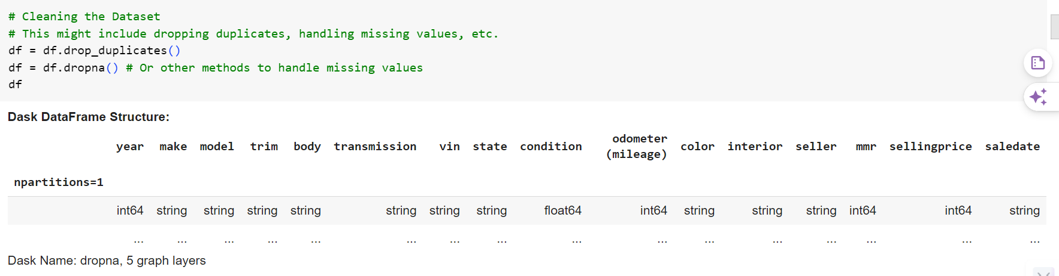
1. Clean the Dataset

Slide 12
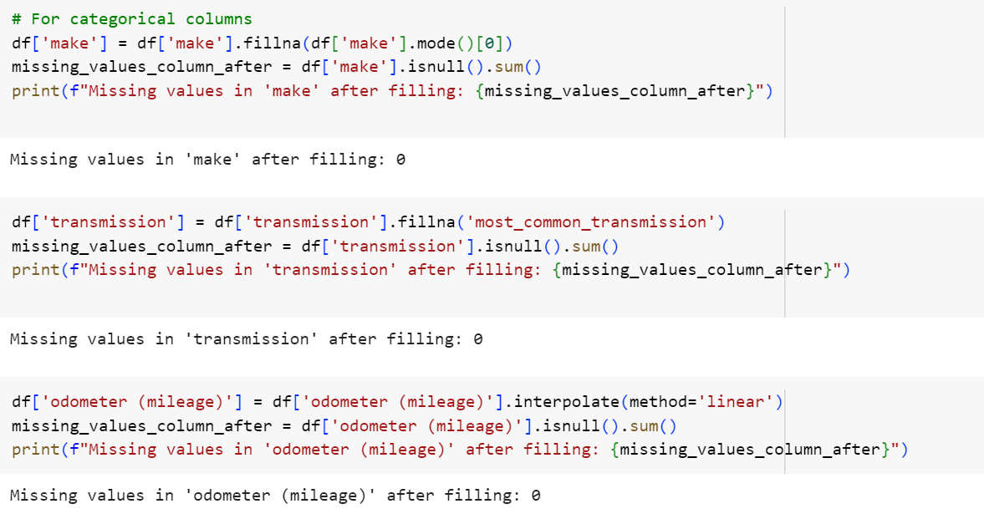
For categorical columns

Slide 13
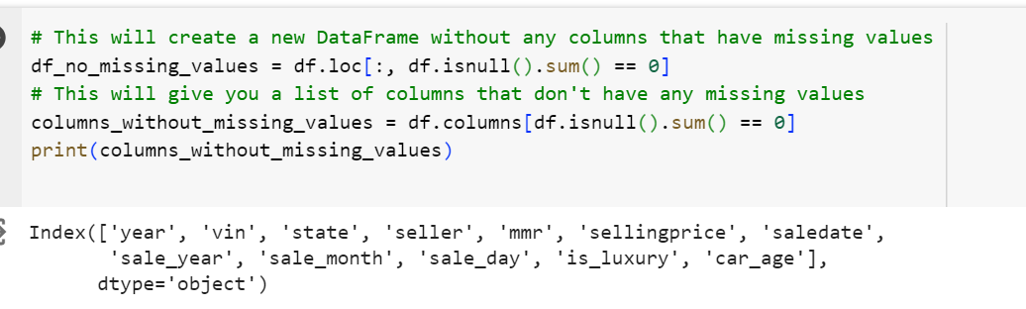
DataFrame to show only columns without any missing values

Slide 14
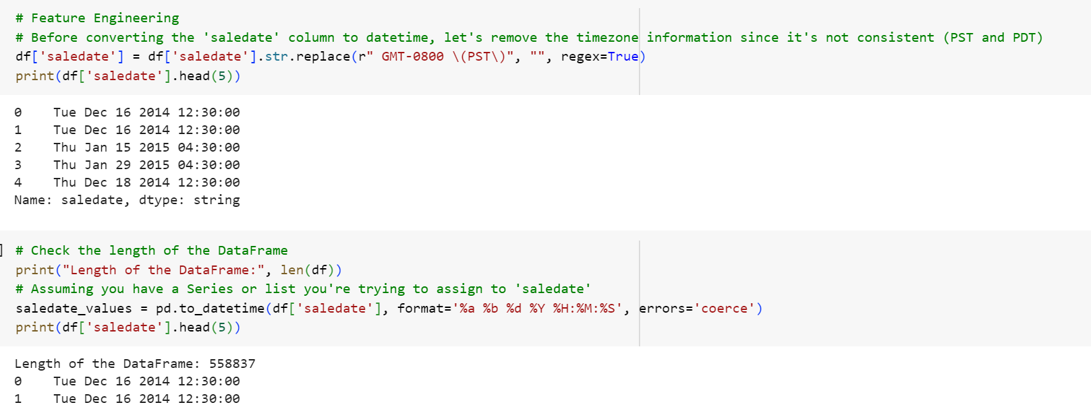
2. Feature Engineer Based off of your experiment Transformation
Performed Date

Slide 15
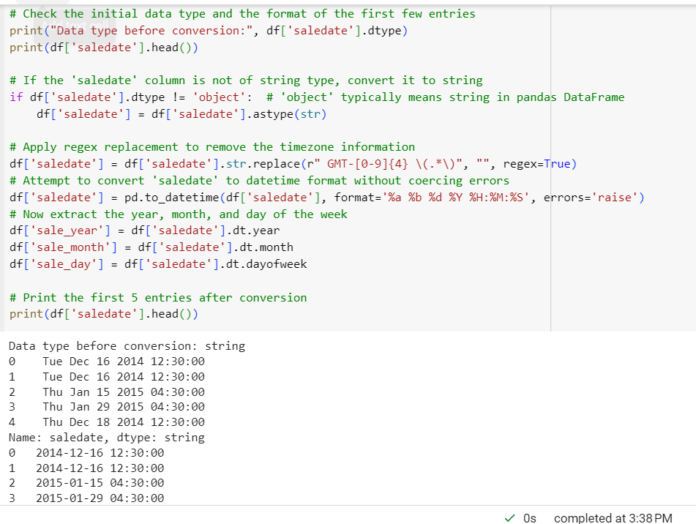
Data type before conversion

Slide 16
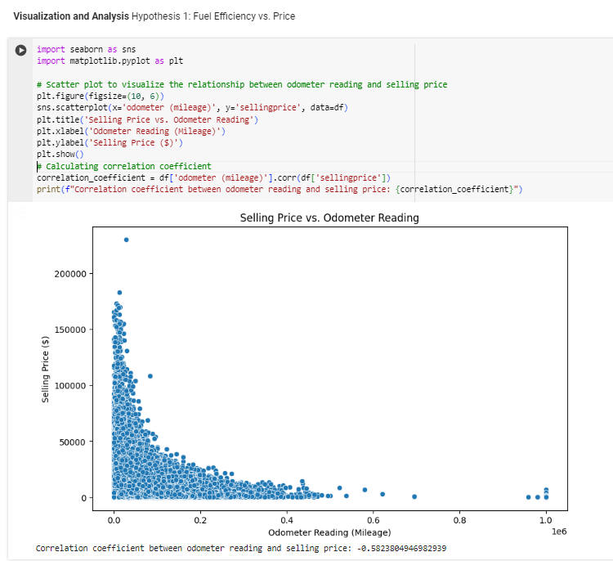
Perform EDA Based off of your Hypotheses

Slide 17
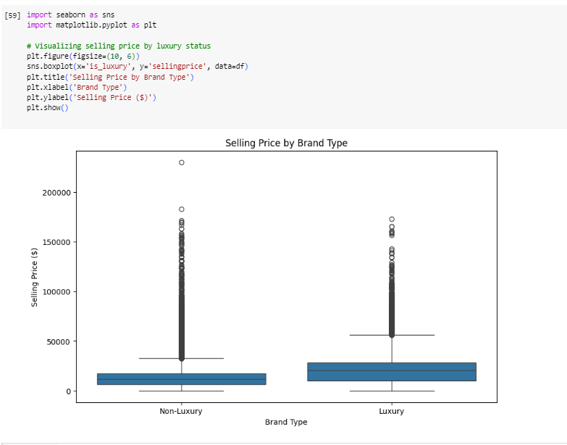
Hypothesis 2: Luxury vs. Non-Luxury Brand Prices

Slide 18
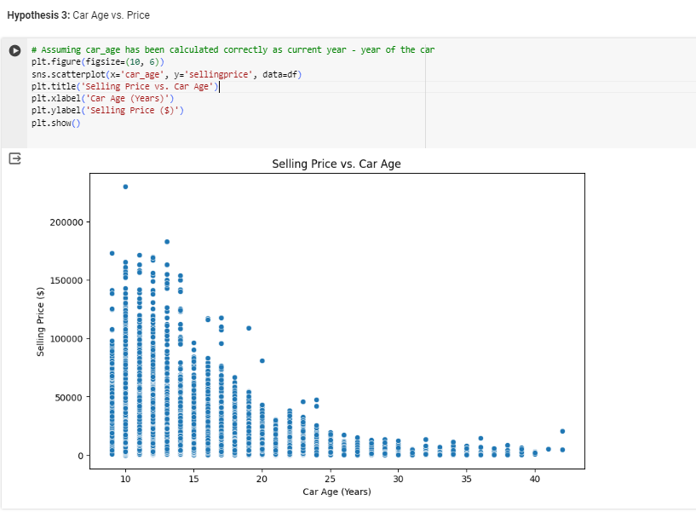
Hypothesis 3: Car Age vs. Price

Slide 19
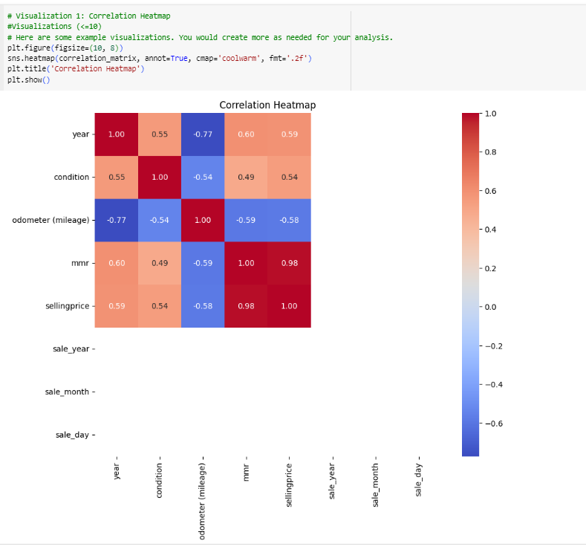
Have <=10 Visualizations : Visualization 1: Correlation Heatmap

Slide 20
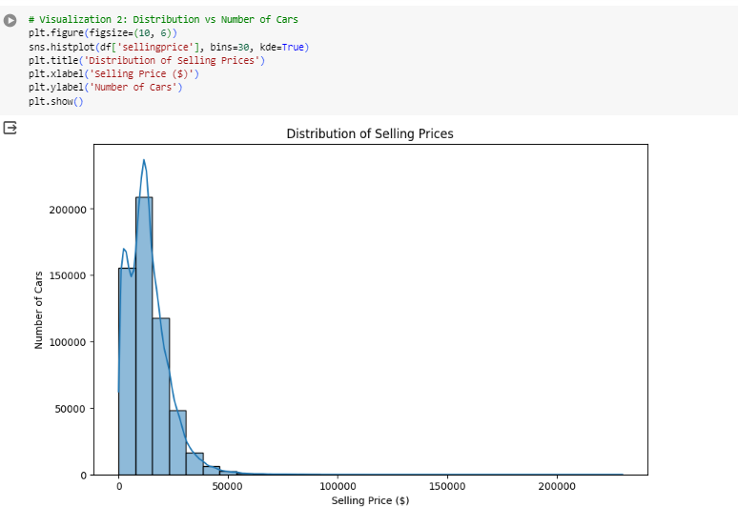
Visualization 2: Distribution vs Number of Cars

Slide 21
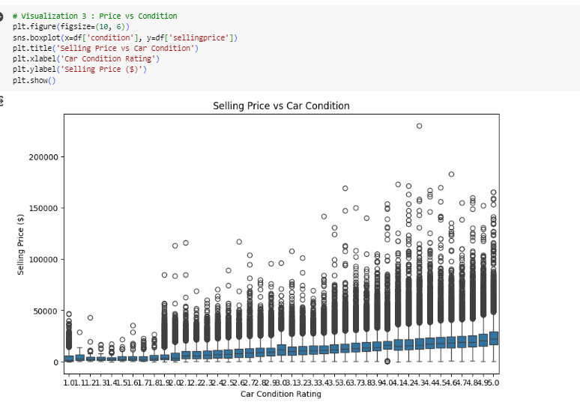
Visualization 3 : Price vs Condition

Slide 22
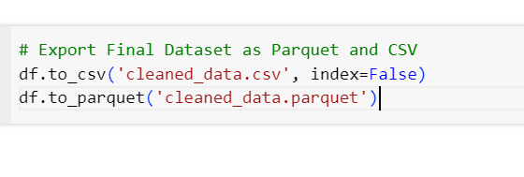
4. Export Final Dataset as Parquet and CSV

Slide 23

Thank you

